Slide 1

Learning Objective
I will be able graph quadratic equations
Enter quietly, please be ready with the following on your desk:
Whiteboard
Whiteboard marker
Exercise Book
Pencil, pen, ruler and red pen
Diary
Calculator (Scientific and ClassPad)
Device – charged or borrowed from Library before maths

Slide 2
Learning Objective
CFU
What will we learn today?
I will be able to graph quadratic equations
CFU
How will you know that you are successful?
Success Criteria
At the end of the lesson, I will be able to:
Describe transformations on a quadratic graph
Sketch quadratic graphs from transformaitons

Slide 3
Transformation of Quadratic Functions
In the same way that objects can be transformed through translations, dilations and reflections, so can quadratic equations.
This notation comes in handy when we are exploring transformations. We will explore how a quadratic function can be dilated, translated and reflected.

Slide 4
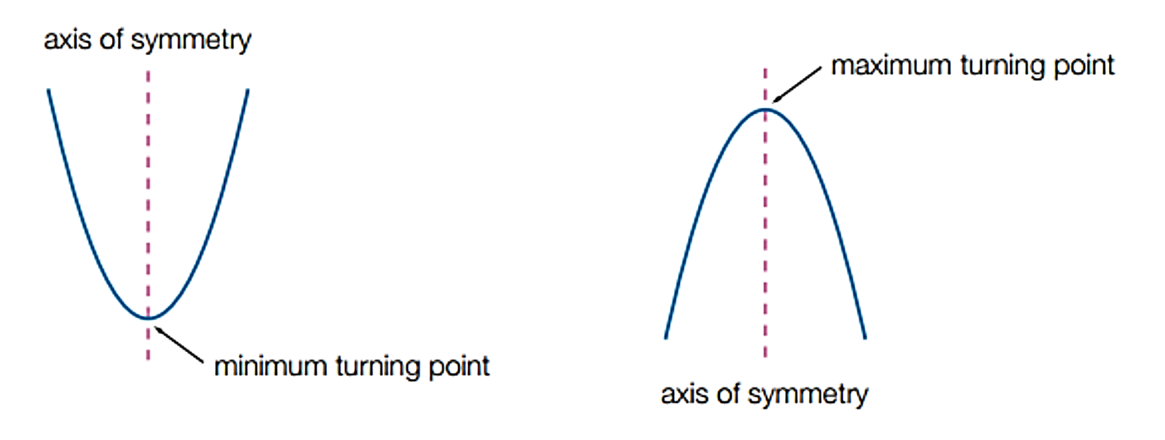
Graphs of Quadratic Functions
The graph of a quadratic function is a parabola, as shown below.
Every parabola has:
A symmetrical shape about the line of symmetry
A turning point that is either a maximum turning point (CONCAVE DOWN) or a minimum turning point (CONCAVE UP)
Changing directions on either side of the turning point.

Slide 5
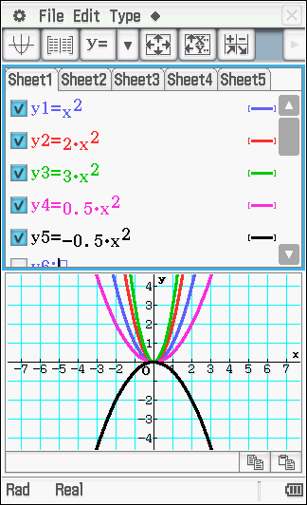

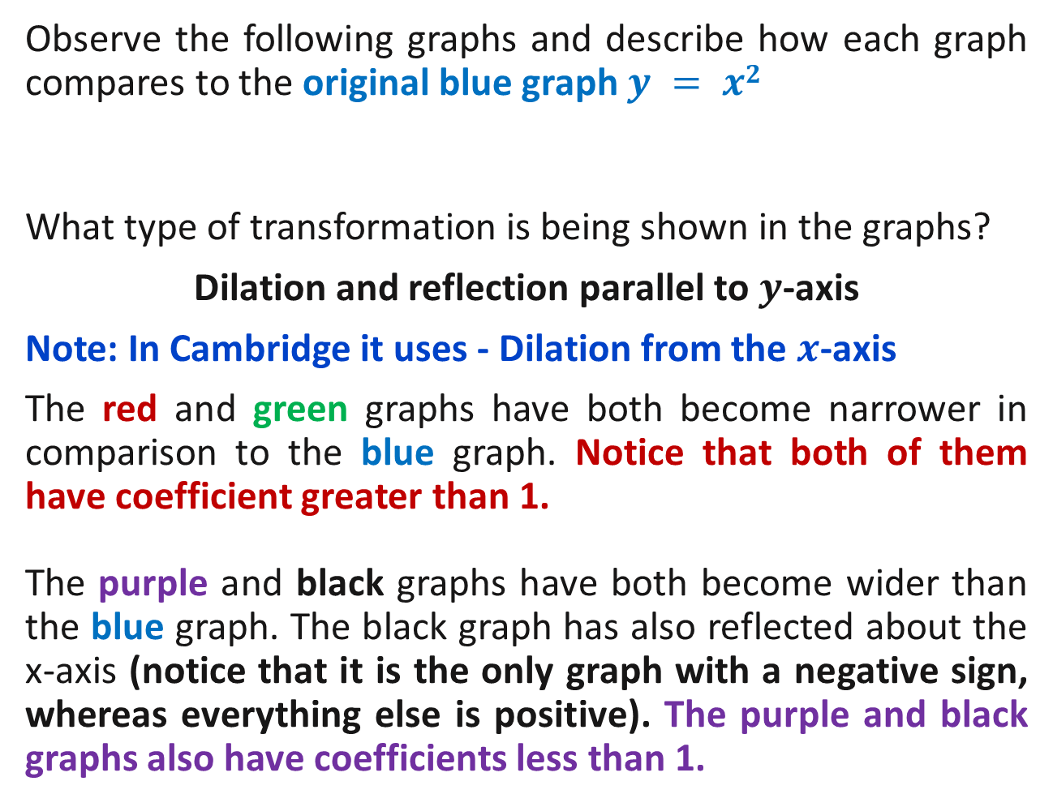
The Graph of $y=ax^{2}$
Observe the following graphs and describe how each graph compares to the original blue graph $y = x2$
What type of transformation is being shown in the graphs?
Dilation and reflection parallel to $y$-axis
Note: In Cambridge it uses - Dilation from the $x$-axis
The red and green graphs have both become narrower in comparison to the blue graph. Notice that both of them have coefficient greater than 1.
The purple and black graphs have both become wider than the blue graph. The black graph has also reflected about the x-axis (notice that it is the only graph with a negative sign, whereas everything else is positive). The purple and black graphs also have coefficients less than 1.

Slide 6
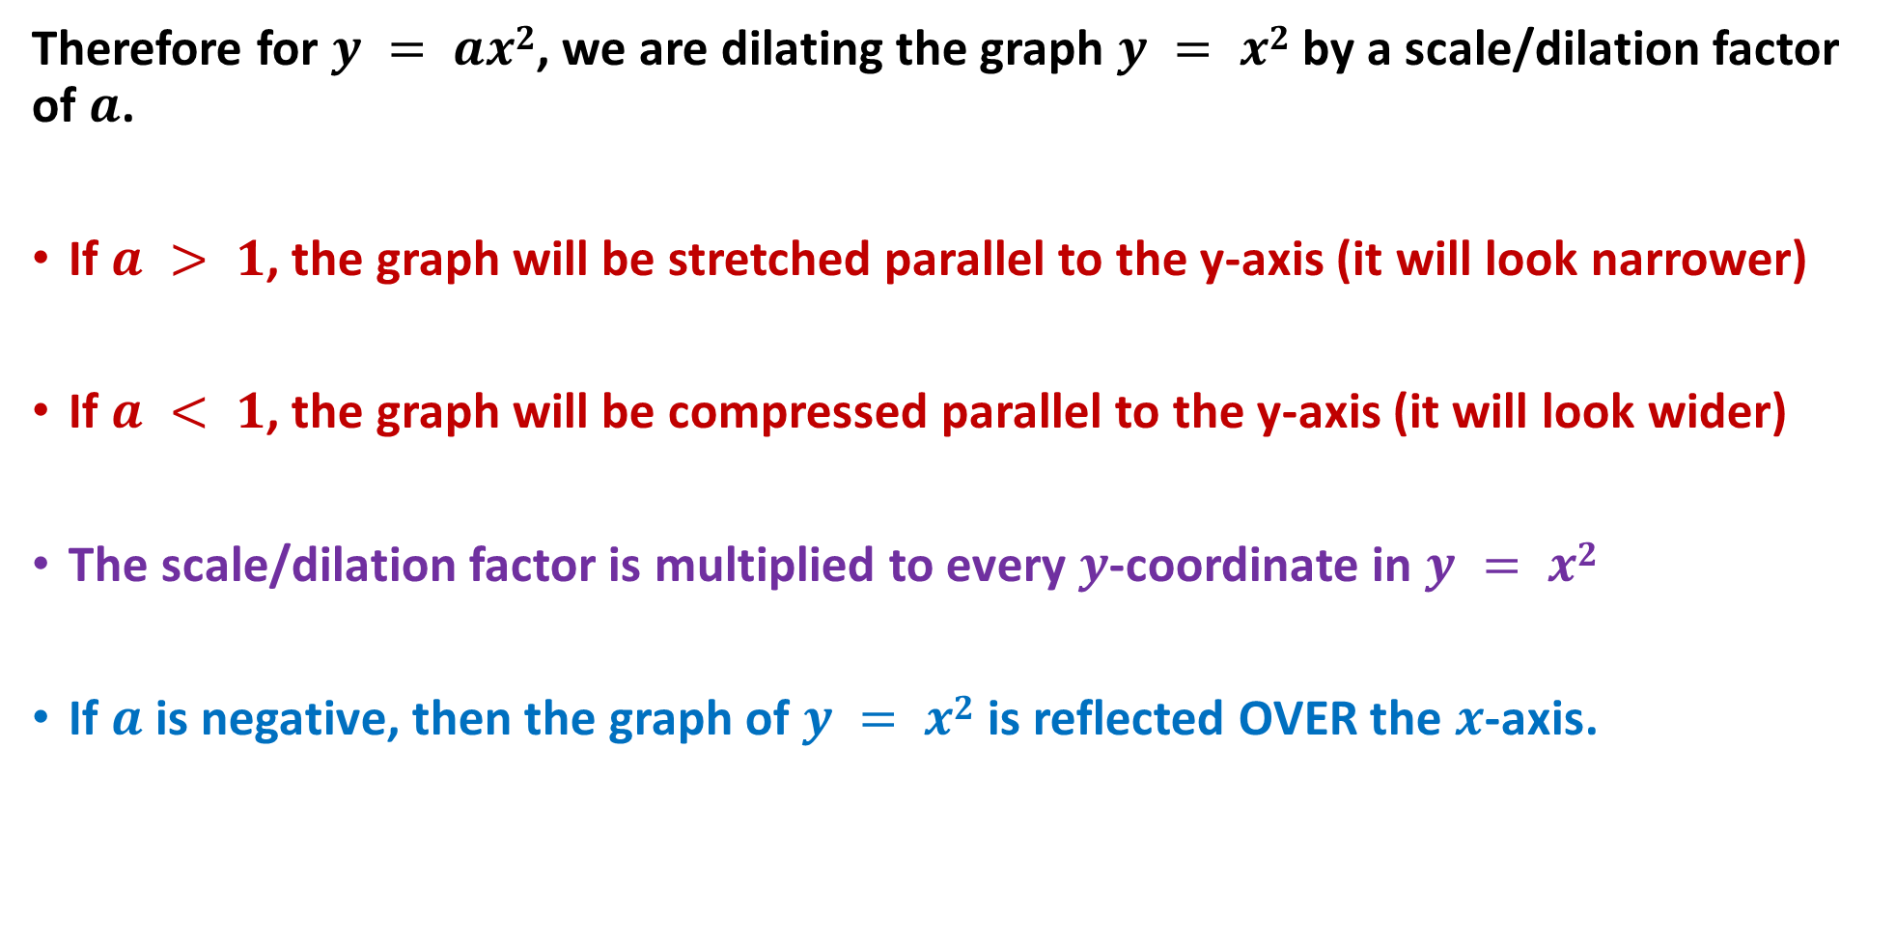
The Graph of $y=ax^{2}$
Therefore for $y = ax2$, we are dilating the graph $y = x2$by a scale/dilation factor of $a$.
If $a > 1$, the graph will be stretched parallel to the y-axis (it will look narrower)
If $a < 1$, the graph will be compressed parallel to the y-axis (it will look wider)
The scale/dilation factor is multiplied to every $y$-coordinate in $y = x2$
If $a$ is negative, then the graph of $y = x2$is reflected OVER the $x$-axis.

Slide 7
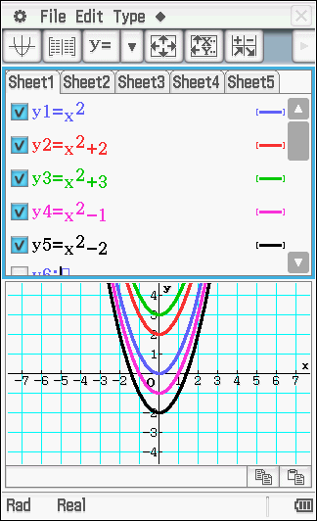
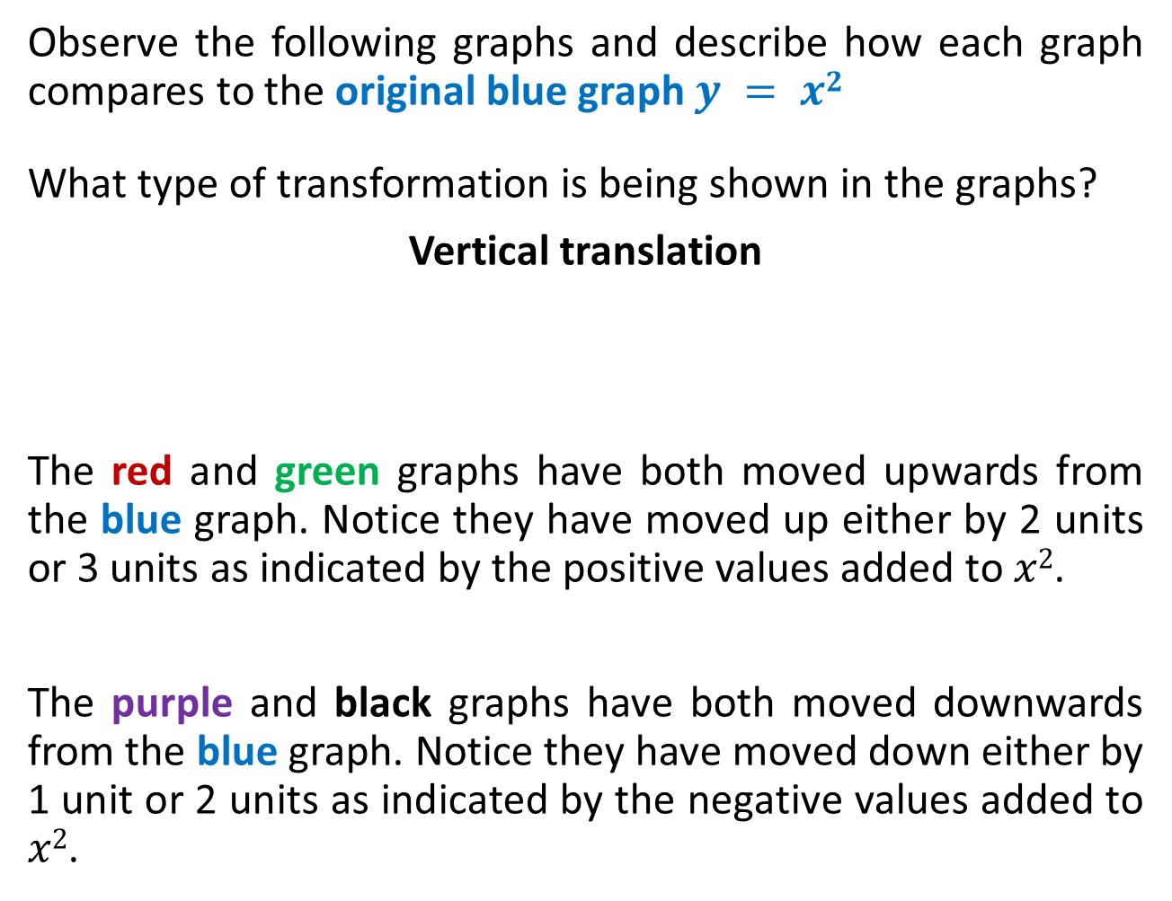
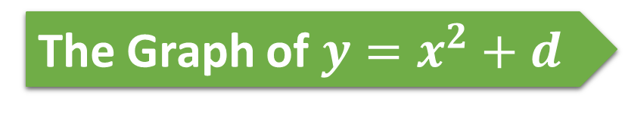
The Graph of $y=x^{2}+d$
Observe the following graphs and describe how each graph compares to the original blue graph $y = x2$
What type of transformation is being shown in the graphs?
Vertical translation
The red and green graphs have both moved upwards from the blue graph. Notice they have moved up either by 2 units or 3 units as indicated by the positive values added to $x2$.
The purple and black graphs have both moved downwards from the blue graph. Notice they have moved down either by 1 unit or 2 units as indicated by the negative values added to $x2$.

Slide 8
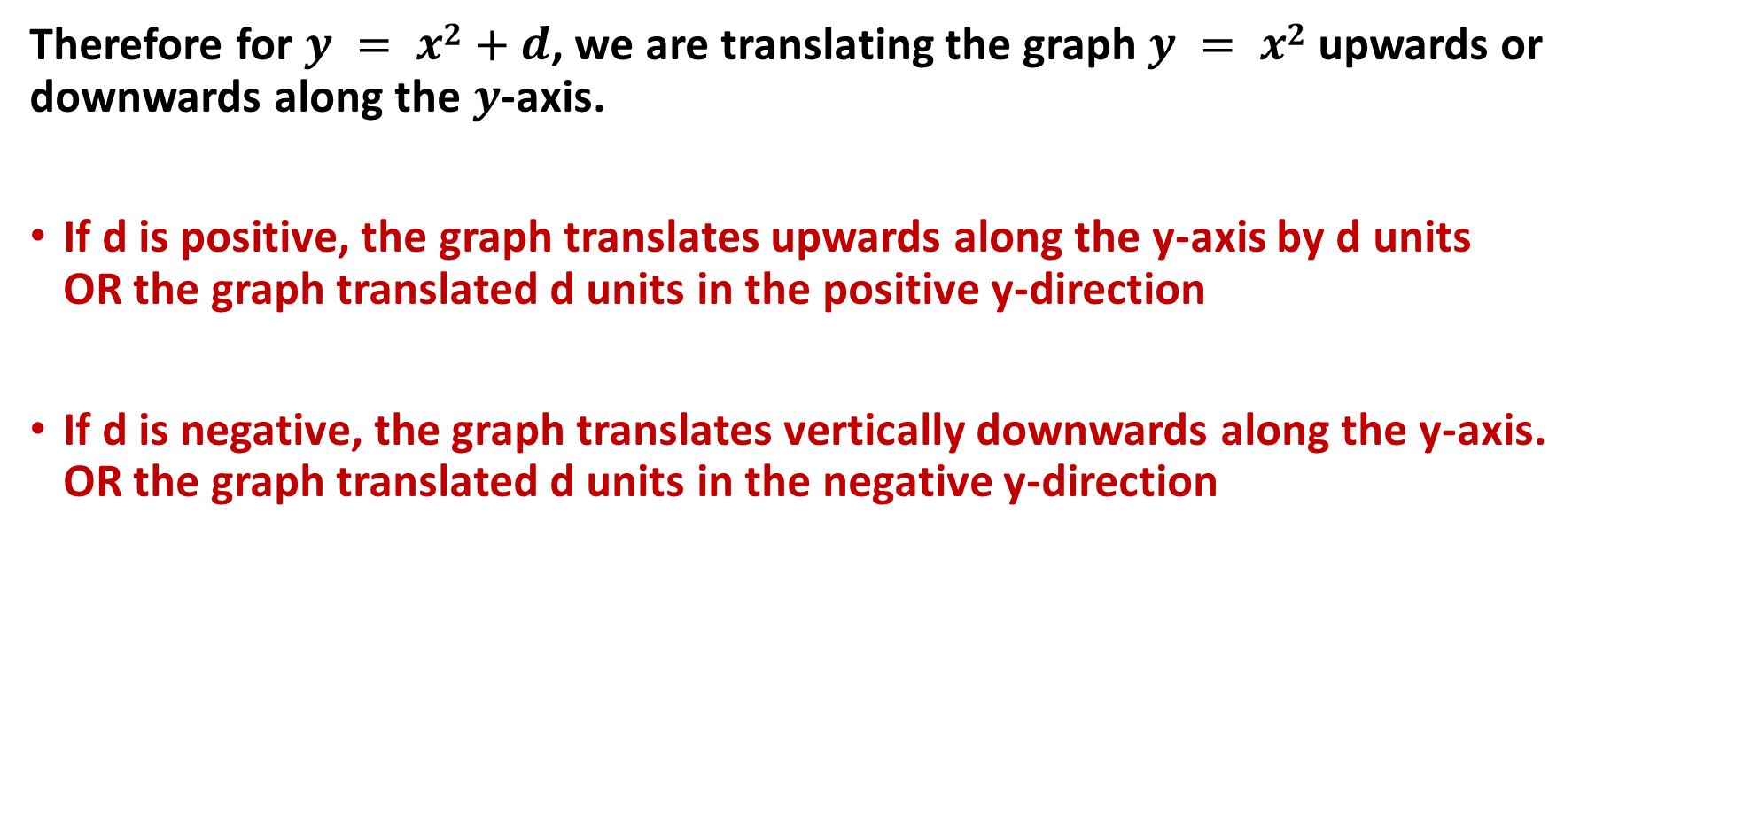
The Graph of $y=x^{2}+d$
Therefore for $y = x2$ $+ d$, we are translating the graph $y = x2$ upwards or downwards along the $y$-axis.
If d is positive, the graph translates upwards along the y-axis by d units OR the graph translated d units in the positive y-direction
If d is negative, the graph translates vertically downwards along the y-axis. OR the graph translated d units in the negative y-direction

Slide 9
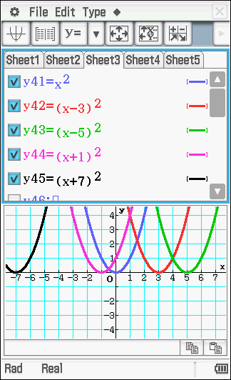
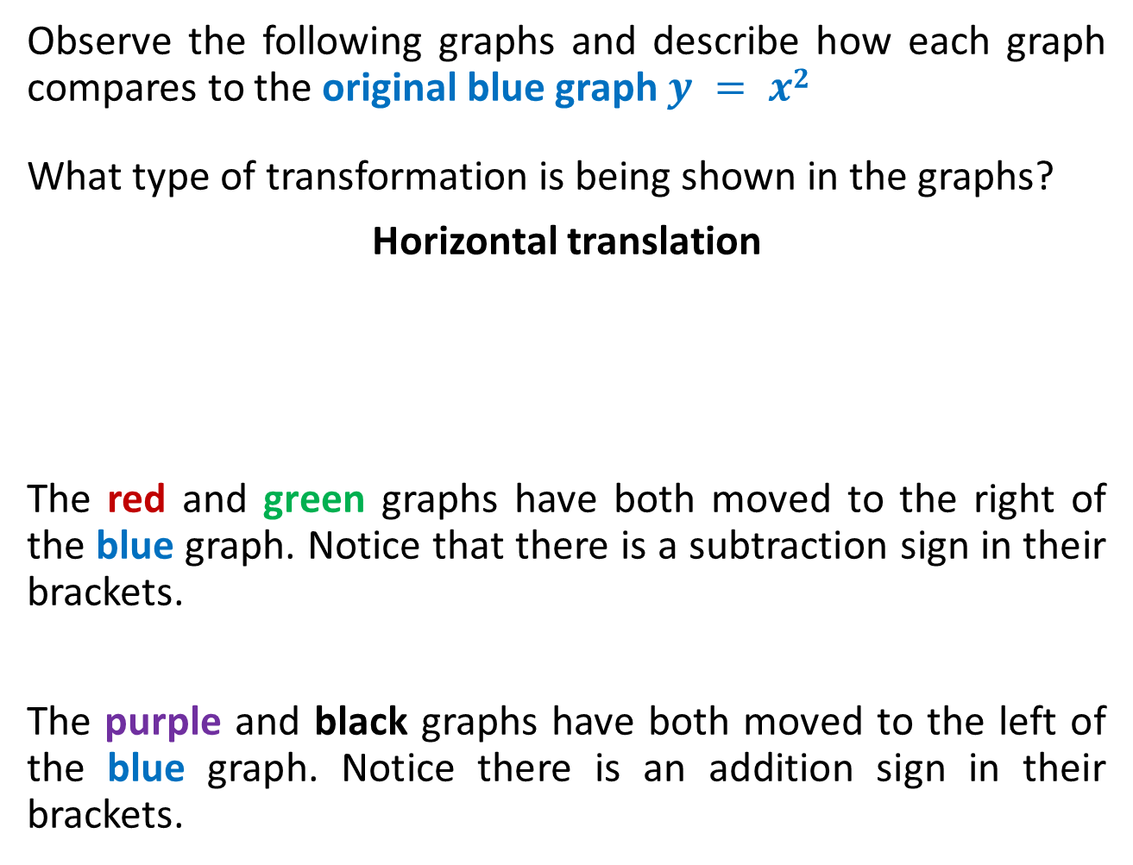

The Graph of $y=(x−c)^{2}$
Observe the following graphs and describe how each graph compares to the original blue graph $y = x2$
What type of transformation is being shown in the graphs?
Horizontal translation
The red and green graphs have both moved to the right of the blue graph. Notice that there is a subtraction sign in their brackets.
The purple and black graphs have both moved to the left of the blue graph. Notice there is an addition sign in their brackets.

Slide 10
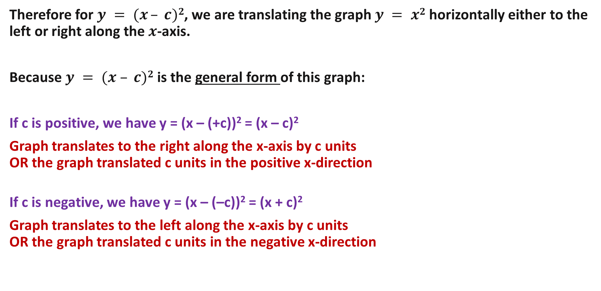
The Graph of $y=(x−c)^{2}$
Therefore for $y = (x – c)2$, we are translating the graph $y = x2$horizontally either to the left or right along the $x$-axis.
Because $y = (x – c)2$is the general form of this graph:
If c is positive, we have y = (x – (+c))² = (x – c)²
Graph translates to the right along the x-axis by c units OR the graph translated c units in the positive x-direction
If c is negative, we have y = (x – (–c))² = (x + c)²
Graph translates to the left along the x-axis by c units OR the graph translated c units in the negative x-direction

Slide 11
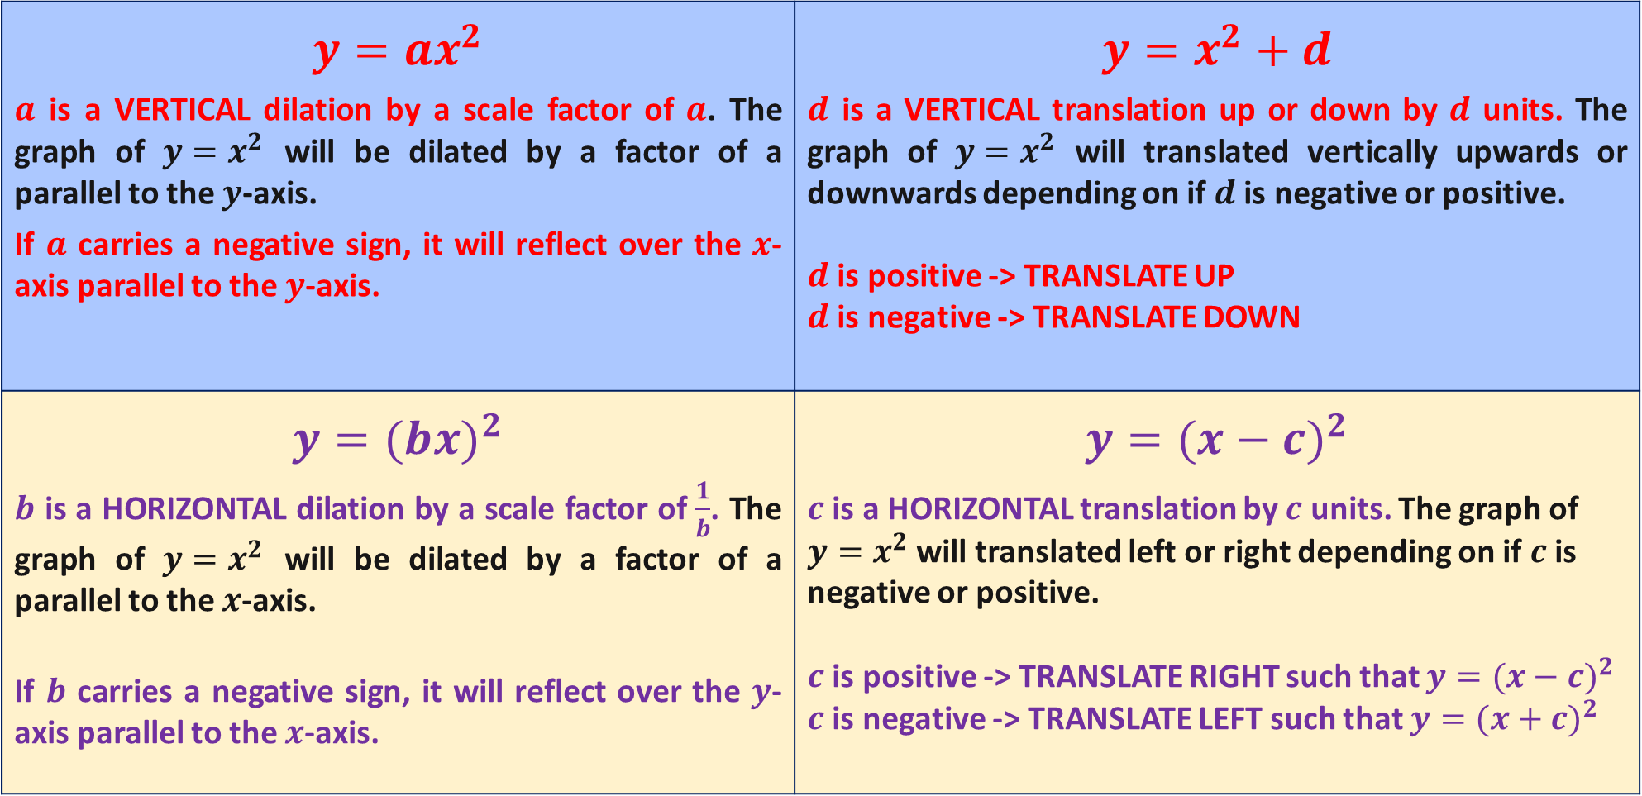
In Summary
$$y=ax^{2}$$ $a$ is a VERTICAL dilation by a scale factor of $a$. The graph of $y=x^{2}$ will be dilated by a factor of a parallel to the $y$-axis. If $a$ carries a negative sign, it will reflect over the $x$-axis parallel to the $y$-axis. | $$y=x^{2}+d$$ $d$ is a VERTICAL translation up or down by $d$ units. The graph of $y=x^{2}$ will translated vertically upwards or downwards depending on if $d$ is negative or positive. $d$ is positive -> TRANSLATE UP $d$ is negative -> TRANSLATE DOWN
$$y=(b{x)}^{2}$$ $b$ is a HORIZONTAL dilation by a scale factor of $\frac{1}{b}$. The graph of $y=x^{2}$ will be dilated by a factor of a parallel to the $x$-axis. If $b$ carries a negative sign, it will reflect over the $y$-axis parallel to the $x$-axis. | $$y=(x−c)^{2}$$ $c$ is a HORIZONTAL translation by $c$ units. The graph of $y=x^{2}$ will translated left or right depending on if $c$ is negative or positive. $c$ is positive -> TRANSLATE RIGHT such that $y=(x−c)^{2}$ $c$ is negative -> TRANSLATE LEFT such that $y=(x+c)^{2}$

Slide 12
Key Terminology for Quadratic Functions
The general shape of a quadratic is a parabola.
Concavity is the slope or steepness of the parabola, affected by the dilation of the graph.
If a parabola is concave down then we have a MAXIMUM TURNING POINT (T.P.) where the graph changes direction from having a +ve slope to having a –ve slope. THIS HAPPENS WHEN WE HAVE A NEGATIVE SIGN IN FRONT OF x²
If a parabola is concave up then we have a MINIMUM TURNING POINT (T.P.) where the graph changes direction from having a –ve slope to having a +ve slope. THIS IS THE USUAL SHAPE OF A QUADRATIC.
Remember CONCAVE UP = ☺ and CONCAVE DOWN = ☹

Slide 13
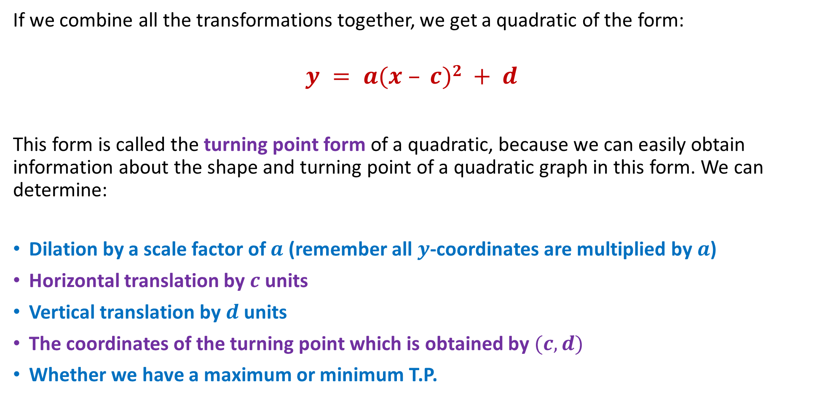
Combining Transformations
If we combine all the transformations together, we get a quadratic of the form:
$$y = a(x – c)2 + d$$
This form is called the turning point form of a quadratic, because we can easily obtain information about the shape and turning point of a quadratic graph in this form. We can determine:
Dilation by a scale factor of $a$ (remember all $y$-coordinates are multiplied by $a$)
Horizontal translation by $c$ units
Vertical translation by $d$ units
The coordinates of the turning point which is obtained by $(c, d)$
Whether we have a maximum or minimum T.P.

Slide 14
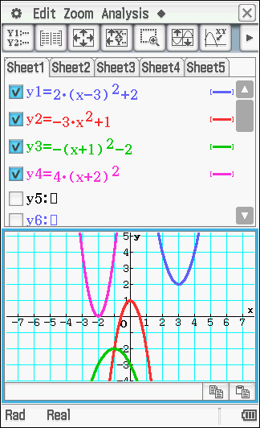
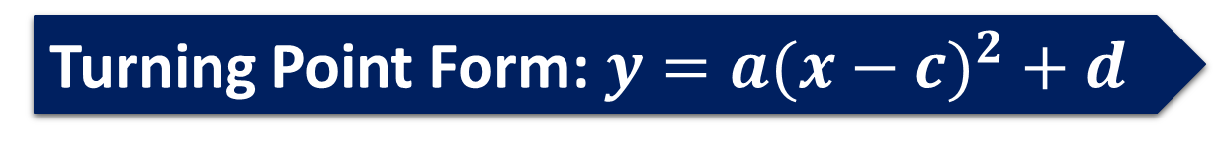
Turning Point Form: $y=a(x−c)^{2}+d$
Describe the transformations and turning points for the graphs shown simply by looking at the equations.
Dilation by a scale factor of 2, with a horizontal translation 3 units to the right, and vertical translation 2 units upwards. The turning point is at (3, 2).
Dilation by a scale factor of 3, with a reflection parallel to the y-axis and a vertical translation upwards by 1 unit. The turning point is at (0, 1).
Reflection parallel to the y-axis with a horizontal translation 1 unit to the left, and vertical translation 2 units downwards. The turning point is at (-1, -2).
Dilation by a scale factor of 4, with a horizontal translation 2 units to the left. The turning point is at (-2, 0).

Slide 15
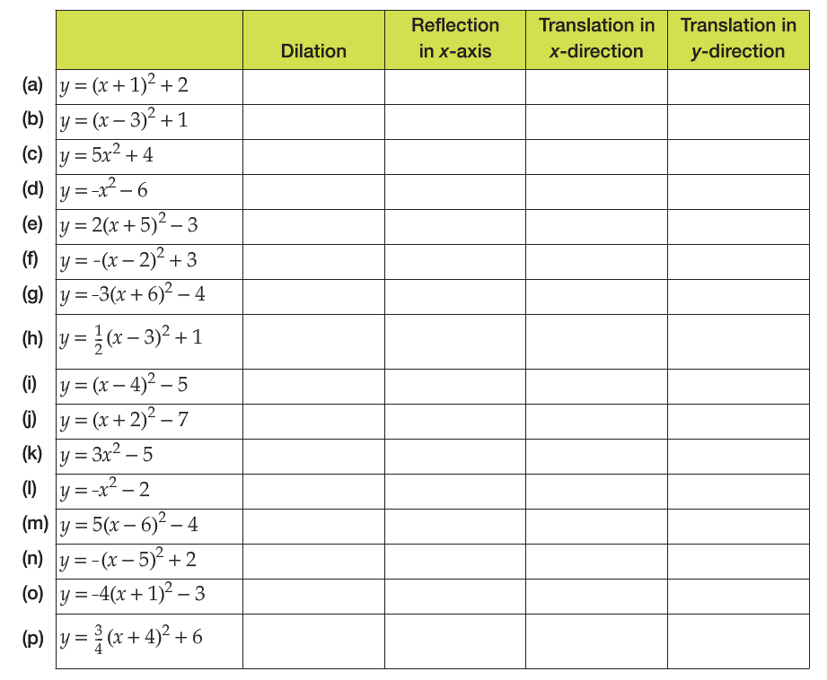


EXAMPLE
No
No
1 unit left
2 units up
No
No
3 units right
1 unit up
Yes, by SF of 5
No
None
4 units up
No
Yes
None
6 units down
Yes, by SF of 2
No
5 units left
3 units down
No
Yes
2 units right
3 units up
Yes, by SF of 3
Yes
6 units left
4 units down
Yes, by SF of $\frac{1}{2}$
No
3 units right
1 unit up
No
No
4 units right
5 units down
No
No
2 units left
7 units down
Yes, by SF of 3
No
None
5 units down
No
Yes
None
2 units down
Yes, by SF of 5
No
6 units right
4 units down
No
Yes
5 units right
2 units up
Yes, by SF of 4
Yes
1 unit left
3 units down
Yes, by SF of $\frac{3}{4}$
No
4 units left
6 units up

Slide 16
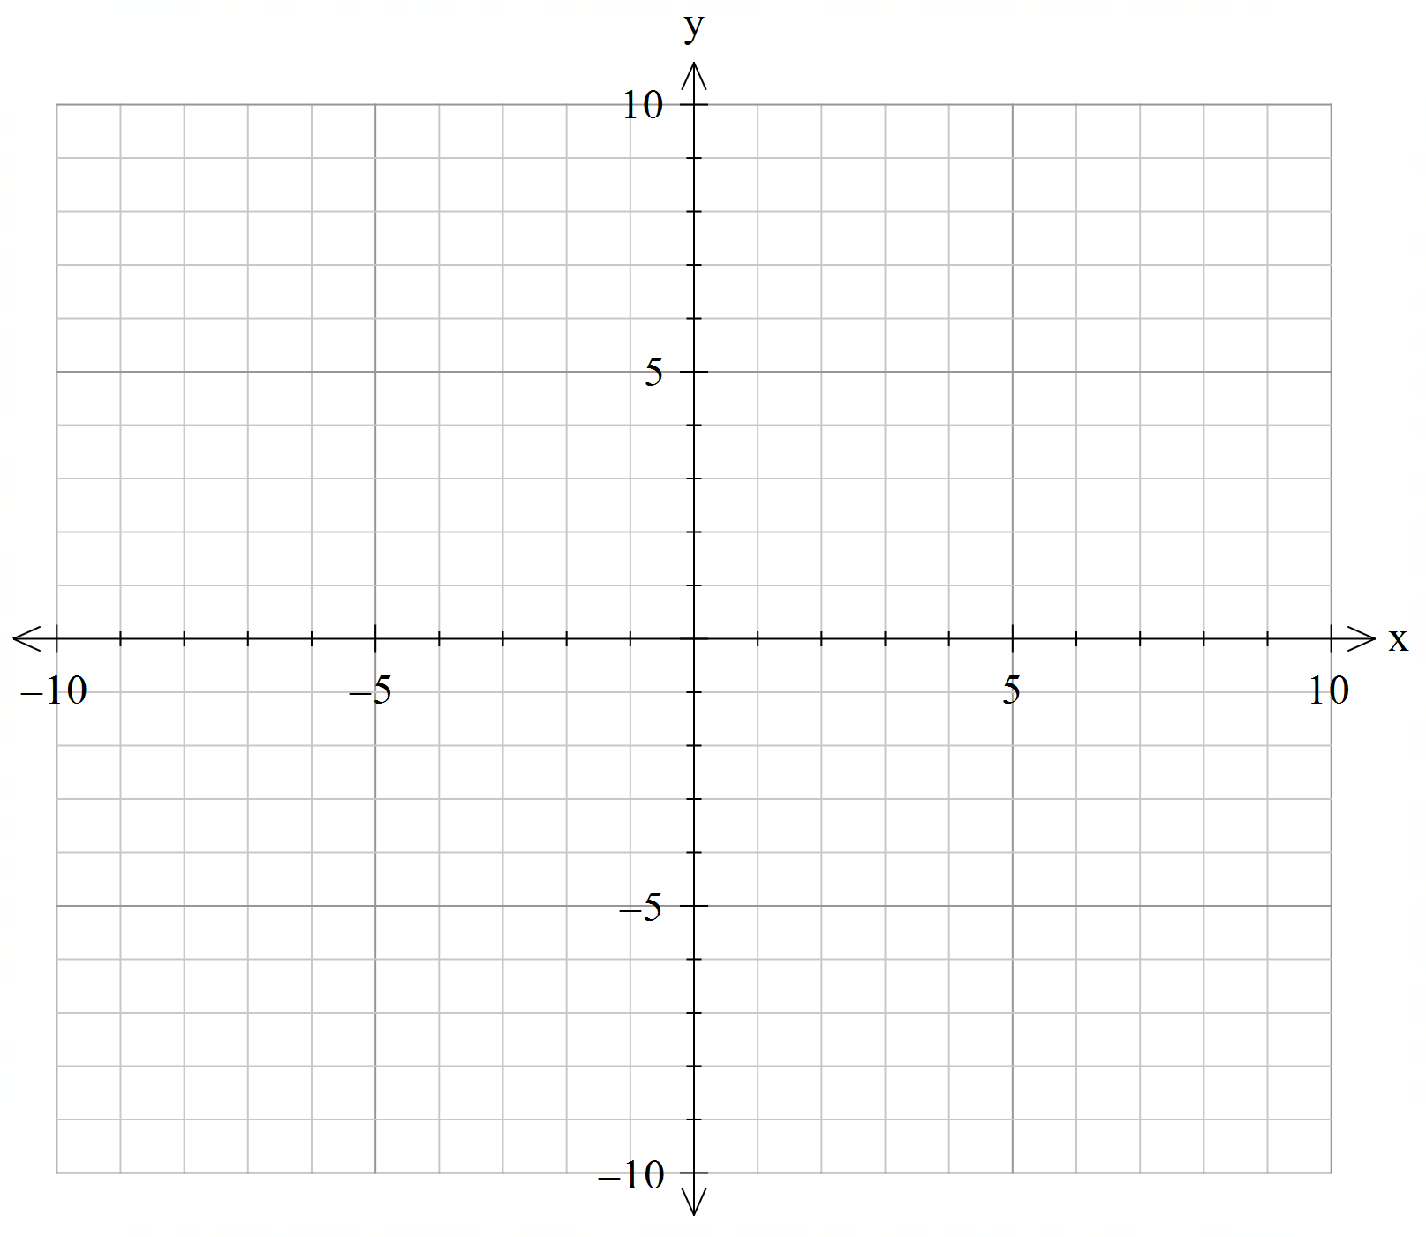

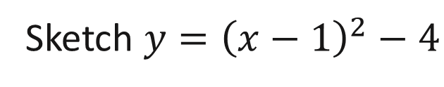
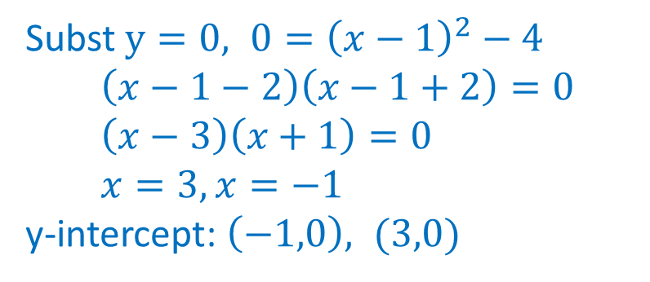
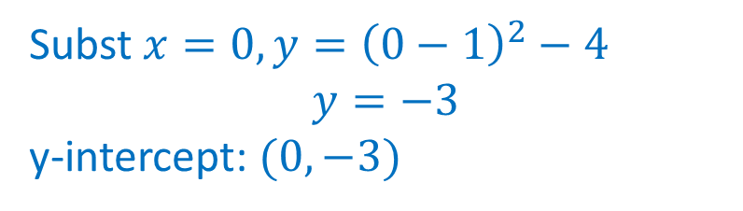
Sketching Graph
Sketch $y={\left(x−1\right)}^{2}−4$
1. Determine turning point and axis of symmetry
$$\left(1,−4\right), x=1$$
2. Determine y-intercept
3. Determine x-intercept
Subst $x=0,y={\left(0−1\right)}^{2}−4$ $$y=−3$$ y-intercept: $(0,−3)$
Subst $y=0, 0={\left(x−1\right)}^{2}−4$ $$\left(x−1−2\right)\left(x−1+2\right)=0 \\ \left(x−3\right)\left(x+1\right)=0 \\ x=3, x=−1$$ y-intercept: $\left(−1,0\right), (3,0)$

Slide 17
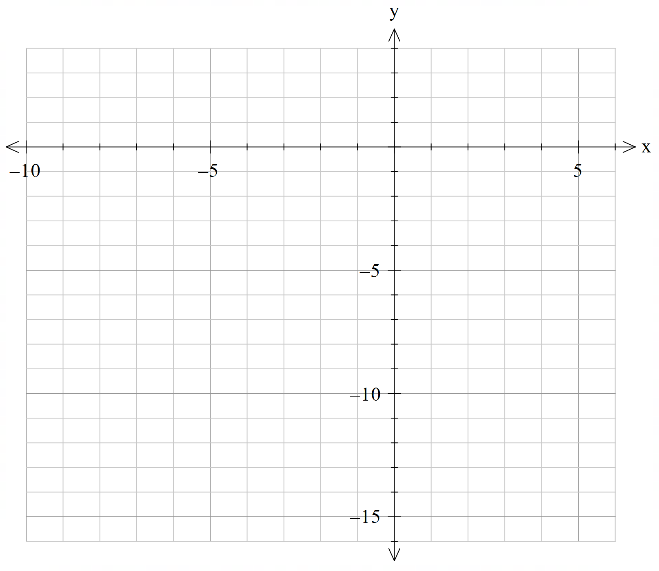
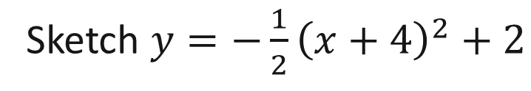
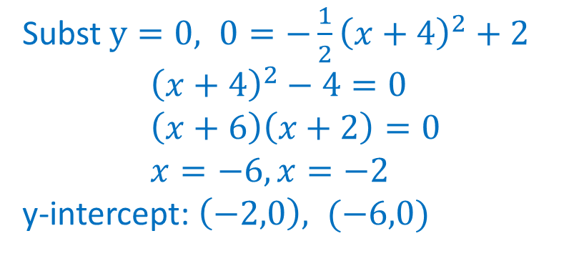
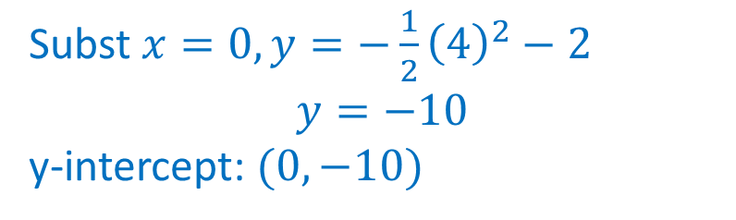

Sketching Graph
Sketch $y={−\frac{1}{2}\left(x+4\right)}^{2}+2$
1. Determine turning point and axis of symmetry
$$\left(−4, 2\right), x=−4$$
2. Determine y-intercept
3. Determine x-intercept
Subst $x=0,y=−\frac{1}{2}{\left(4\right)}^{2}−2$ $$y=−10$$ y-intercept: $(0,−10)$
Subst $y=0, 0={−\frac{1}{2}\left(x+4\right)}^{2}+2$ $${\left(x+4\right)}^{2}−4=0 \\ \left(x+6\right)\left(x+2\right)=0 \\ x=−6, x=−2$$ y-intercept: $\left(−2,0\right), (−6,0)$

Slide 18
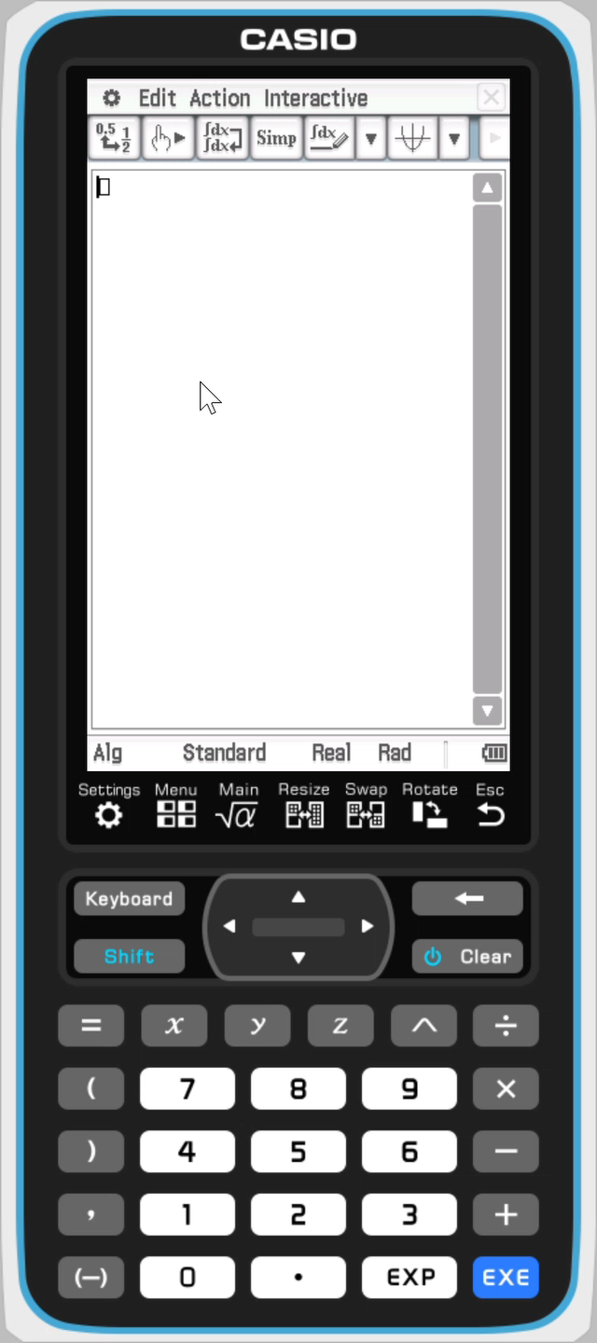
Sketching Graph – ClassPad (Main)
Sketch $y={−\frac{1}{2}\left(x+4\right)}^{2}+2$
1. Determine turning point and axis of symmetry
2. Determine y-intercept
3. Determine x-intercept

Slide 19
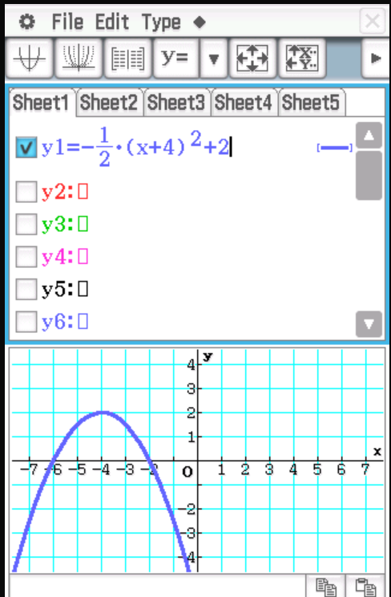
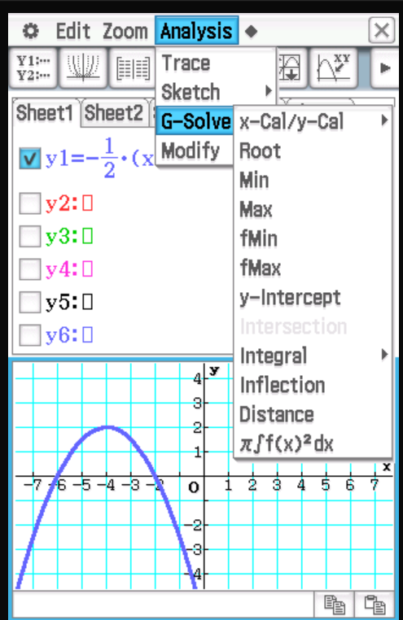
Sketching Graph – ClassPad (Graphs)
Sketch $y={−\frac{1}{2}\left(x+4\right)}^{2}+2$
1. Determine turning point and axis of symmetry
2. Determine y-intercept
3. Determine x-intercept

Slide 20
Independent Practice
Cambridge Ex 3D

